Slide 1






Heart Disease Risk Prediction
Turning Health Data into Life-Saving Predictions
Team Matrix | Data Science Capstone Project – 2025
Exploratory Analysis
Predictive Modeling
Clinical Insights
November 8th, 2025

Slide 2













Background & Objective
Background:
Objective
Heart disease remains a leading global killer, but early, data-driven detection using machine learning can reveal hidden risk patterns often missed by traditional methods.
Build an interpretable ML model to predict heart disease risk from non-invasive clinical indicators.
Support early diagnosis and enhance clinical decision-making through data insights.
Features Used
Age
Cholesterol
Chest Pain Type
Blood Pressure
Exploratory Data Analysis
Uncovering key physiological and lifestyle factors that significantly influence the presence of heart disease through visualizing patterns within the data.
Heart Disease Risk Prediction Project
Page 2 of 10

Slide 3

















Dataset Overview: Kaggle Heart Disease Dataset
Dataset Source
Features Description
Publicly accessible Kaggle heart disease dataset.
age
sex
cp
Shape: 1,025 records → 302 unique after cleaning
Patient's age in years
Gender (0=female, 1=male)
Chest pain type
Numerical
Categorical
Categorical
Features: 14
trestbps
chol
fbs
Resting blood pressure in mm Hg
Serum cholesterol in mg/dl
Fasting blood sugar > 120 mg/dl
Numerical
Numerical
Numerical
Target Variable
Target: Presence of heart disease (1 = disease, 0 = no disease)
restecg
thalach
exang
Resting electrocardiographic results
Maximum heart rate achieved
Exercise-induced angina
Categorical
Numerical
Categorical
Balance: Nearly 54% positive cases, 46% negative cases.
oldpeak
slope
ca
ST depression induced by exercise
Slope of ST segment
Number of major vessels
Numerical
Categorical
Categorical
thal
target
Thalassemia status
Presence of heart disease
Categorical
Binary
Heart Disease Risk Prediction Project
Page 3 of 10

Slide 4















Data Preparation and Preprocessing
Ensuring data fidelity was paramount for accurate heart disease risk modeling. The following steps were taken to prepare the dataset:
Data Loading & Inspection
Data Preprocessing
Column Renaming
Imported required libraries (Pandas, Numpy, etc.)
Categorical variables in the dataset were pre-encoded into numerical representations.
Replaced encoded column names with descriptive labels
Loaded raw dataset with 1025 rows and 14 columns
Maintained two versions: 'df' for modeling and ‘df_eda' for visualization and easy reading
Examples: `cp → chest_pain_type`, `trestbps → resting_blood_pressure`
Inspected structure, feature names, and layout
Enhanced readability and interpretability
Data Quality Checks
Duplicate Record Checks
Checked for missing values
Identified 723 duplicate rows among 1,025 records
Confirmed complete dataset with no null entries
Removed duplicates to prevent biased model predictions
All 14 columns had 1,025 non-null entries
Final clean dataset retained 302 unique patient records
Verified appropriate data types in both 'df' and 'df_eda' ('int' in 'df' due to encoding) to ensure consistency for analysis.
Unlikelihood of exact duplicates in clinical measurements for different patients
Heart Disease Risk Prediction Project
Page 4 of 10

Slide 5




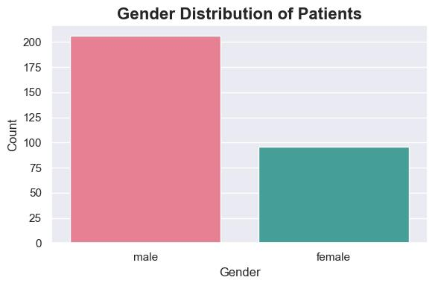
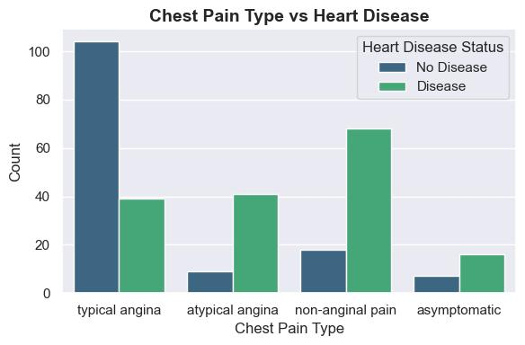
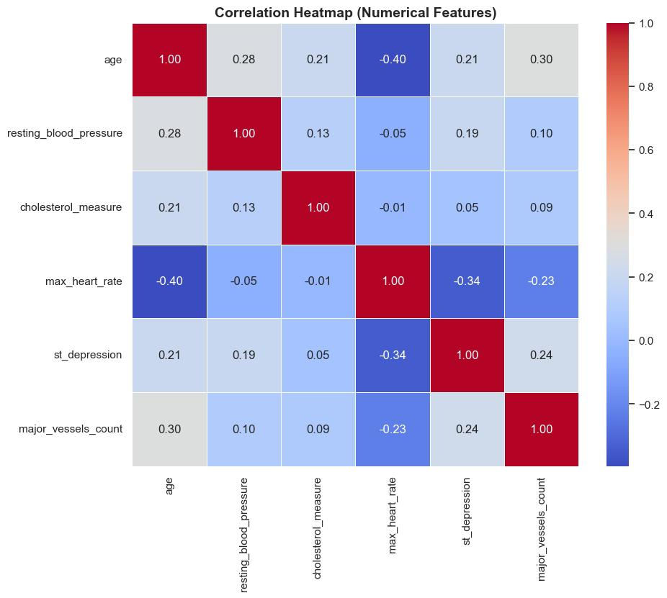



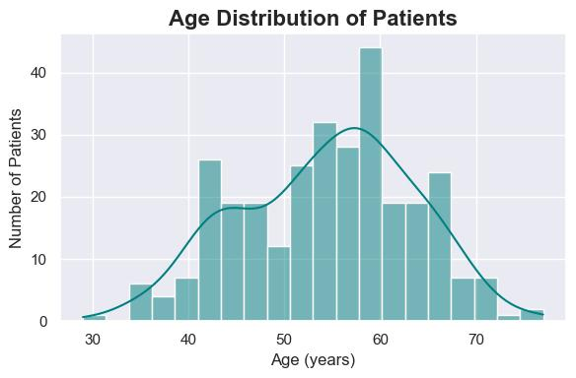
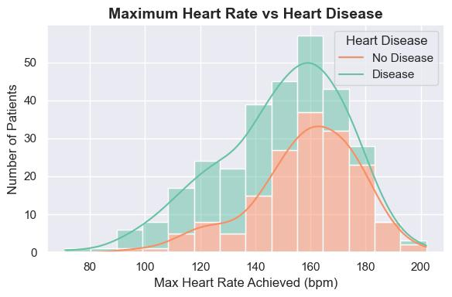
Exploratory Data Analysis (EDA)
Univariate Analysis Findings
Bivariate Analysis Findings
Multivariate Analysis Findings
Gender Representation
Chest Pain Type vs Target
Correlation Heatmap
Nearly balanced distribution with 164 patients having heart disease and 138 without.
Non-anginal & atypical angina strongly linked to heart disease
Typical angina more common without disease
Age Patterns
Maximum Heart Rate
Age: Lower max heart rate (-0.40) and higher BP (0.28) / vessel count (0.30) → higher risk.
ST Depression: Higher values → (0.24) more vessel blockage, lower heart performance (-0.34).
Cholesterol & BP: Weak correlation (<0.20) → act independently.
Majority of high-risk cases in patients aged 40-65, indicating middle-aged adults are most affected.
Near bell-shaped curve, peaking around 150-170 bpm, with lower outliers potentially reflecting older patients.
No strong multicollinearity (>0.8 correlation) found
Heart Disease Risk Prediction Project
Page 5 of 10

Slide 6





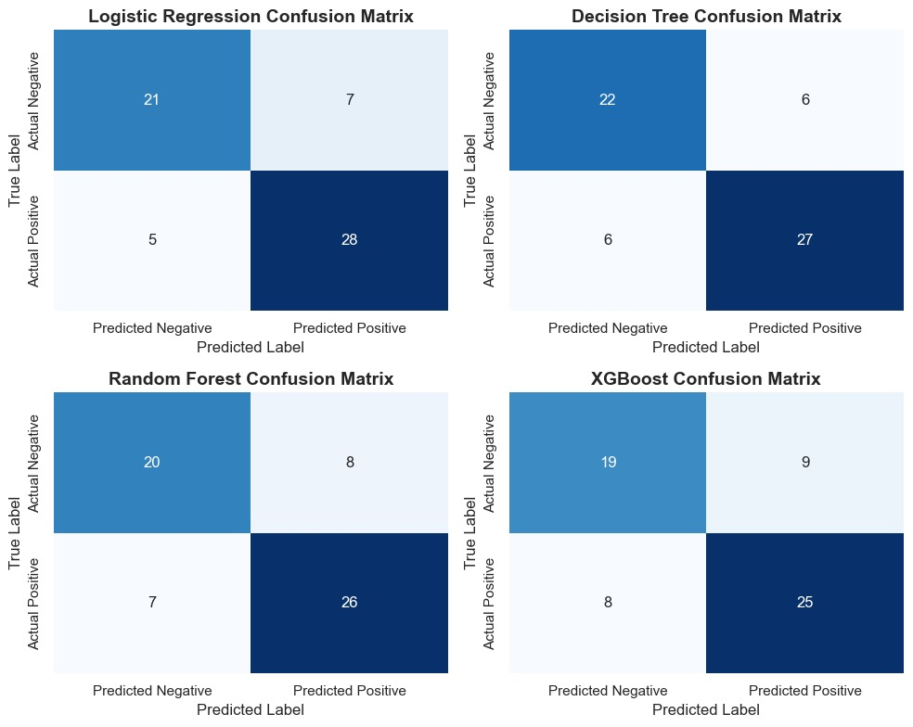
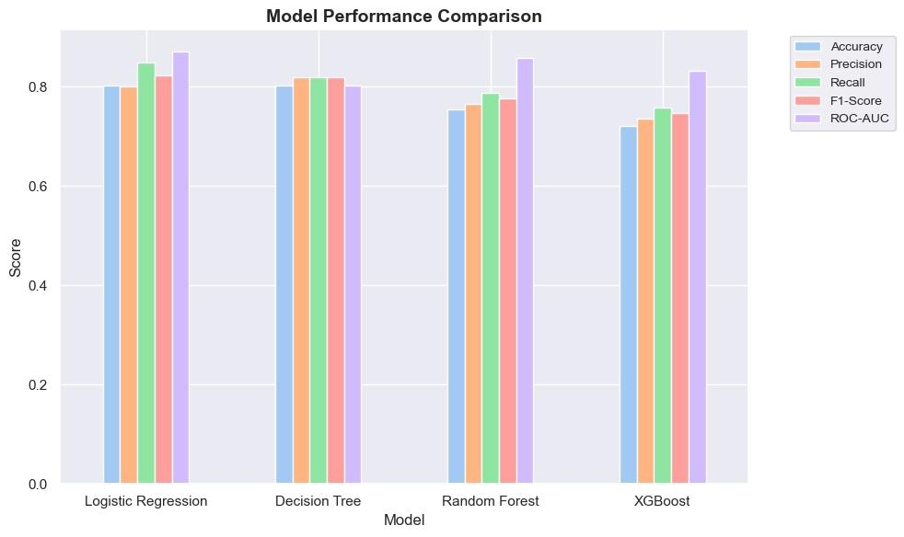
Modeling Approach
Algorithms Tested
Learning Outcome:
Confusion Matrix:
Logistic Regression: strong, interpretable baseline
Decision Tree: simple and visual model
Random Forest: ensemble boosting accuracy
XGBoost: (dropped pre-tuning); strong on tabular data
Feature Selection:
Chest pain, thal status, and vessel count ranked top, but all features retained for completeness
Training Process:
Performance Overview:
GridSearchCV for tuning
Metrics: Accuracy, Recall, Precision, F1, ROC-AUC
Cross-validation to enhance generalization
Models trained on scaled data using an 80/20 train-test split.
Compared both baseline and tuned models
Logistic Regression offered best interpretability–performance balance (AUC = 0.87)
Surpassed Decision Tree (0.80), Random Forest (0.86), and XGBoost (0.83)
XGBoost (0.83) showed moderate performance with signs of overfitting.
Most predictions fall on the diagonal: the model accurately distinguishes patients with and without heart disease.
Heart Disease Risk Prediction Project
Page 6 of 10

Slide 7



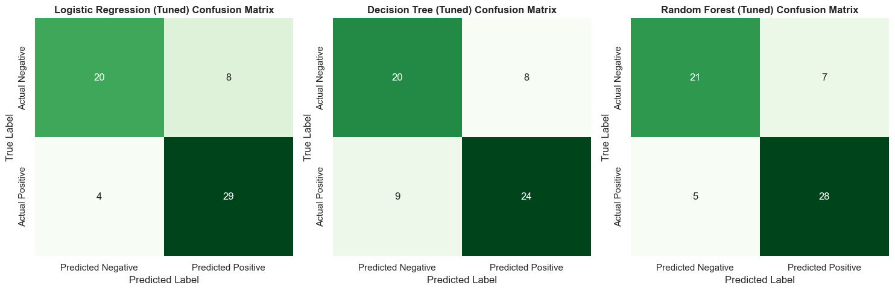
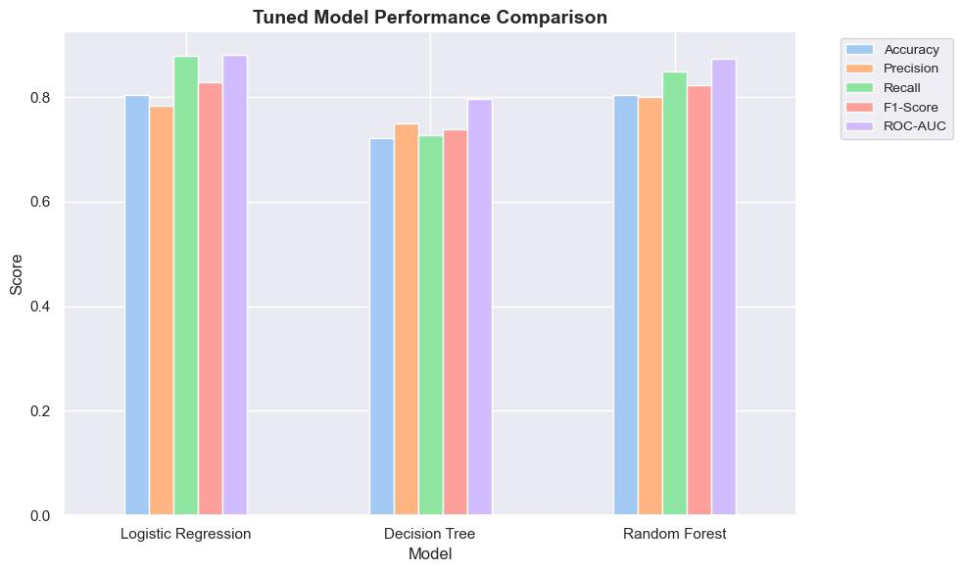

Model Tuning & Evaluation Results
After hyperparameter tuning and cross-validation, the models were evaluated on key performance metrics.
Tuned models show strong overall performance.
Correctly identified most positives (29 & 28) with few false negatives (4 & 5).
Decision Tree misclassified more positives (9) — slightly weaker performance.
Logistic Regression and Random Forest deliver more reliable, consistent predictions.
Key Insights
Logistic Regression achieved the best recall (0.88) and ROC-AUC (0.88).
Random Forest remained competitive (0.87).
Decision Tree overfitted slightly.
Heart Disease Risk Prediction Project
Page 7 of 10

Slide 8



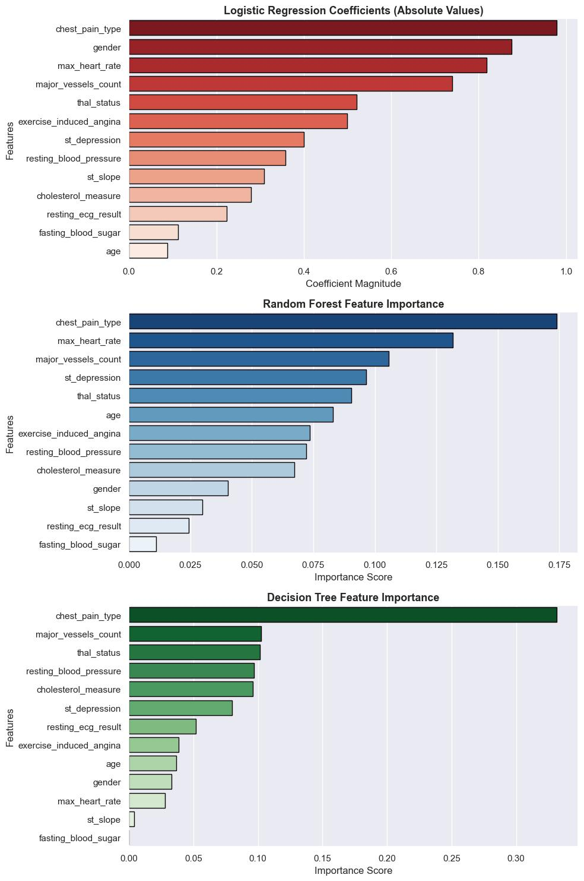






Feature Importance & Clinical Insights
Top Predictors:
Chest Pain Type
Maximum Heart Rate (thalach)
Major Vessels Count (ca)
ST Depression (oldpeak)
Thalassemia Status (thal)
Clinical Relevance:
Chest Pain Type: Key indicator of coronary artery blockage.
Maximum Heart Rate: Lower rates signal weaker heart performance.
Major Vessels Count: Higher counts imply reduced blood flow.
ST Depression: Reflects cardiac stress and ischemia.
Thalassemia Status: Indicates impaired oxygen transport efficiency.
Functional heart indicators predict disease risk better than demographics — showing how data-driven models can align with real clinical understanding.
Heart Disease Risk Prediction Project
Page 8 of 10

Slide 9


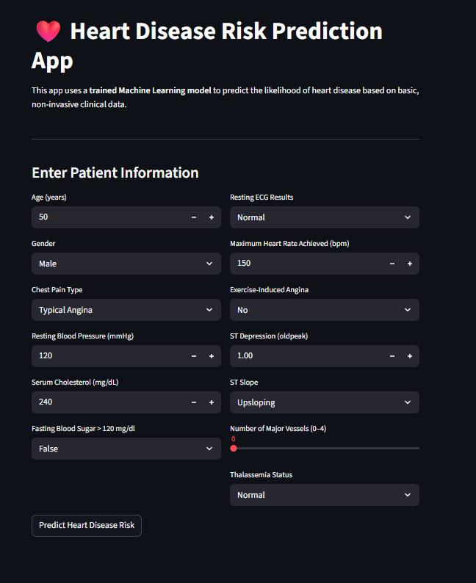




Model Deployment
Deployment Platform: Streamlit
App Features:
User inputs patient data
Max Heart Rate
Built on Logistic Regression (primary)
Applications:
Early screening support for clinicians
Potential use in hospital dashboards & EHR systems
Low-cost diagnostic aid in resource-limited settings
Clinical Recommendation: The final model balances (0.87) AUC performance with the high interpretability of Logistic Regression, essential for transparent and trustworthy clinical deployment.
Page 9 of 10
Heart Disease Risk Prediction Project

Slide 10






Conclusion & Future Work
Conclusion:
Future Work
Final Model
Gender
Expand dataset for greater population diversity
Logistic Regression chosen as final model (AUC = 0.88, F1 = 0.83)
Males exhibited higher prevalence of heart disease
Predict disease severity, not just presence
Validation
Reliability
Integrate ECG/imaging data for improved diagnostic accuracy
Random Forest validated complex feature patterns as a supporting model
High interpretability and recall make it a reliable clinical support tool
These findings establish a robust foundation for predictive model development.
Machine learning may be powered by algorithms, but it is guided by human purpose: to help people live longer, healthier lives by turning health data into life-saving predictions.
Heart Disease Risk Prediction Project
Page 10 of 10

